Slide 1
Cost Optimization and Cluster Management
Rohan Chaudhari
Vishal Jha

Slide 2
Agenda
Project Statement
Project Overview
Project Requirements
Architecture Diagram
Implementation
Conclusion

Slide 3
Project Statement
Create a project that optimizes costs and manages Databricks clusters efficiently using PySparkSQL. Implement & explain auto-scaling policies, optimize query performance, and monitor resource utilization.

Slide 4
Project Overview
The primary goal of this project is to achieve cost optimization and efficient cluster management in Databricks by implementing auto-scaling policies, optimizing query performance, and monitoring resource utilization. By following these steps, the project will help reduce costs, improve performance, and ensure the efficient use of resources in Databricks clusters.

Slide 5
Project Requirements
Azure Subscription
Azure Databricks
Cluster
Auto Scale
Databricks Notebook
Sparksql

Slide 6
Azure Databricks
Azure Databricks is like a super-smart workspace in the cloud where you can easily analyse and process large amounts of data using the power of Apache Spark.

Slide 7
Cluster
A cluster refers to a group of virtual or physical machines (nodes) that work together to process and analyze large volumes of data. Clusters are essential for handling the computational and storage requirements of big data workloads.

Slide 8
Auto Scale
Auto Scale is a feature that automatically adjusts the number of compute resources (such as virtual machines or instances) in a cluster based on the workload. It helps optimize resource usage and ensures that the cluster has enough capacity to handle varying levels of demand without manual intervention.

Slide 9
Databricks Notebook
Azure Databricks Notebooks are interactive, collaborative environments for data scientists and engineers to explore, visualize, and analyze data using languages like Python, Scala, SQL, and R. They integrate seamlessly with Azure services and provide built-in support for Apache Spark, enabling scalable data processing and machine learning workflows.

Slide 10
Sparksql
SparkSQL is a module in Apache Spark that provides a programming interface for working with structured data. It allows users to run SQL queries and access data using the DataFrame API, enabling seamless integration of SQL queries with Spark's distributed processing capabilities.

Slide 11
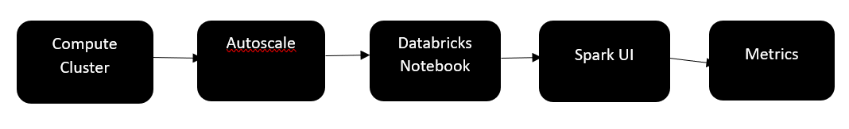
Architecture Diagram

Slide 12
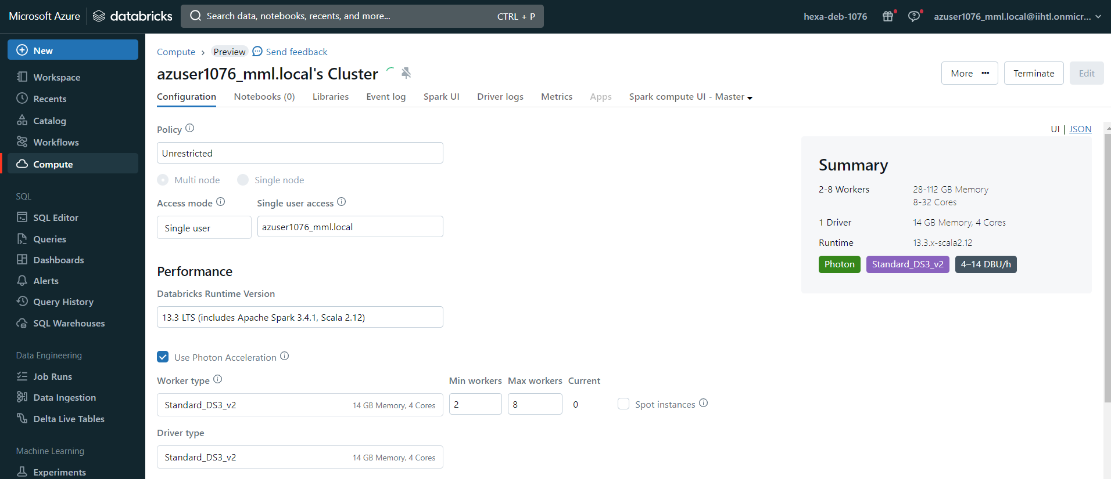
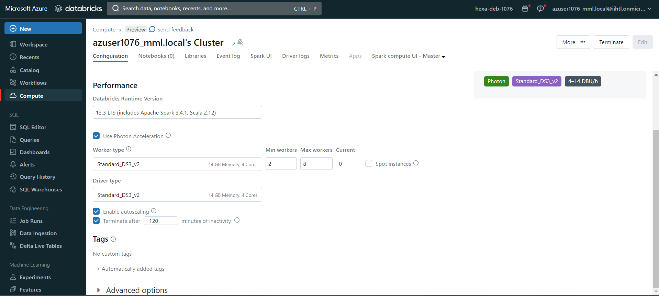
Implementation
Creating Cluster
Autoscaling

Slide 13
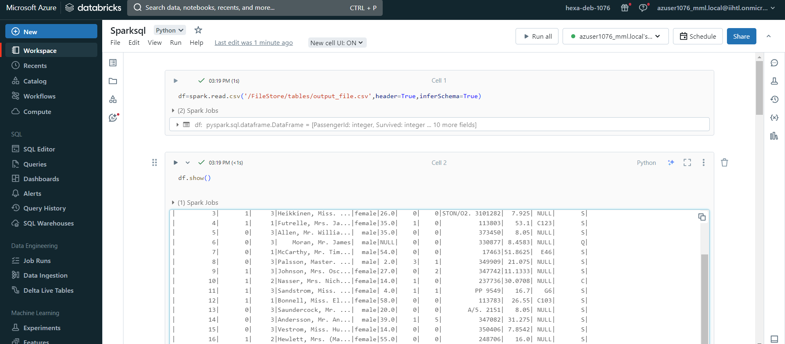
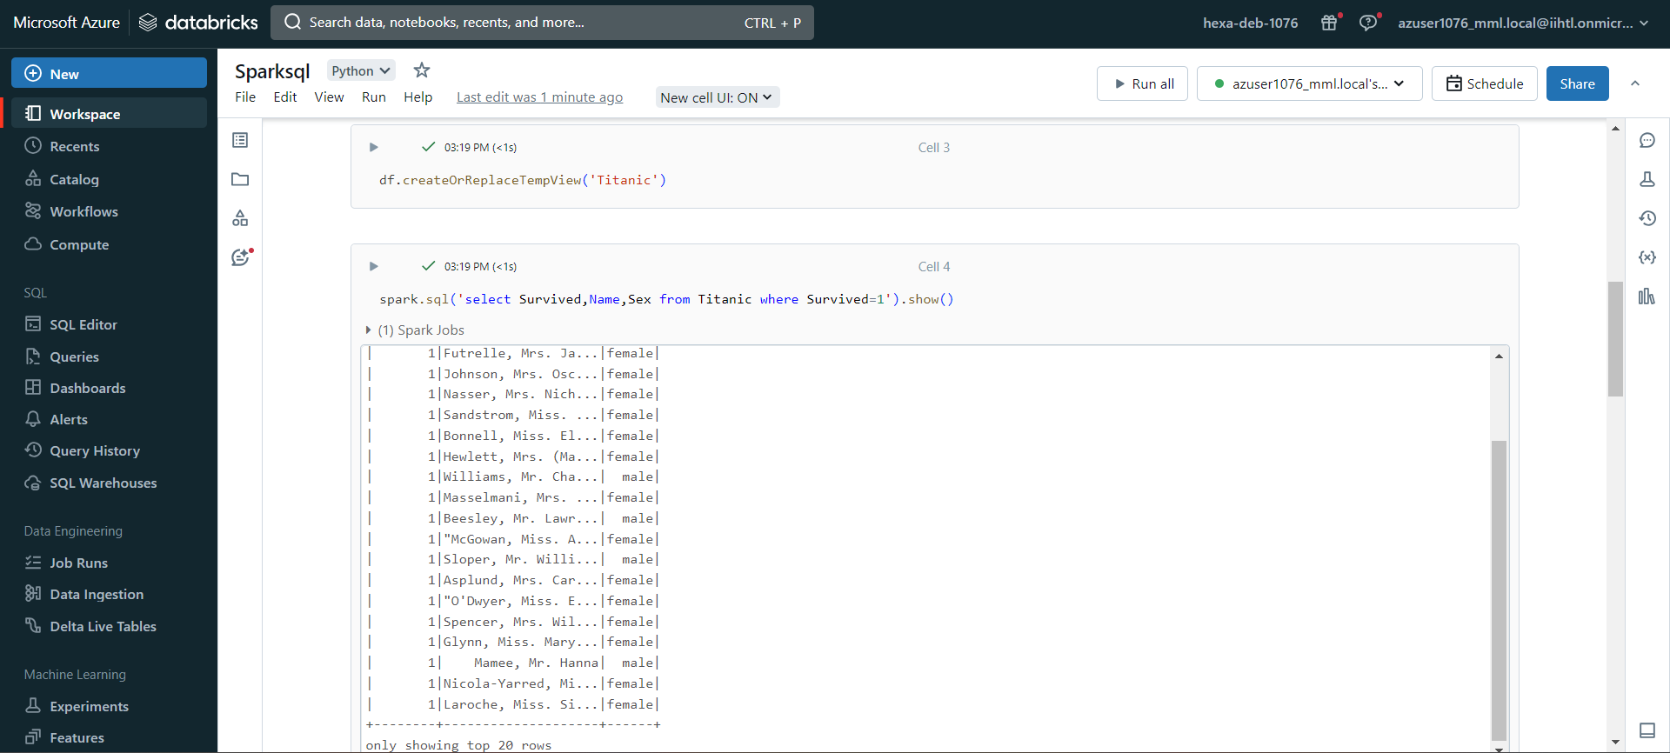
Reading data
Sparksql query

Slide 14
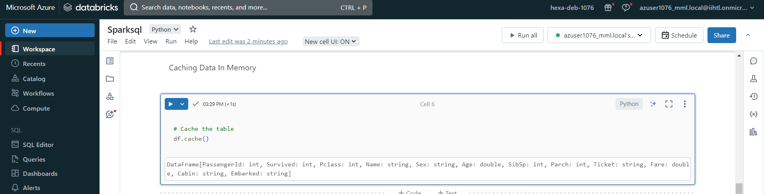
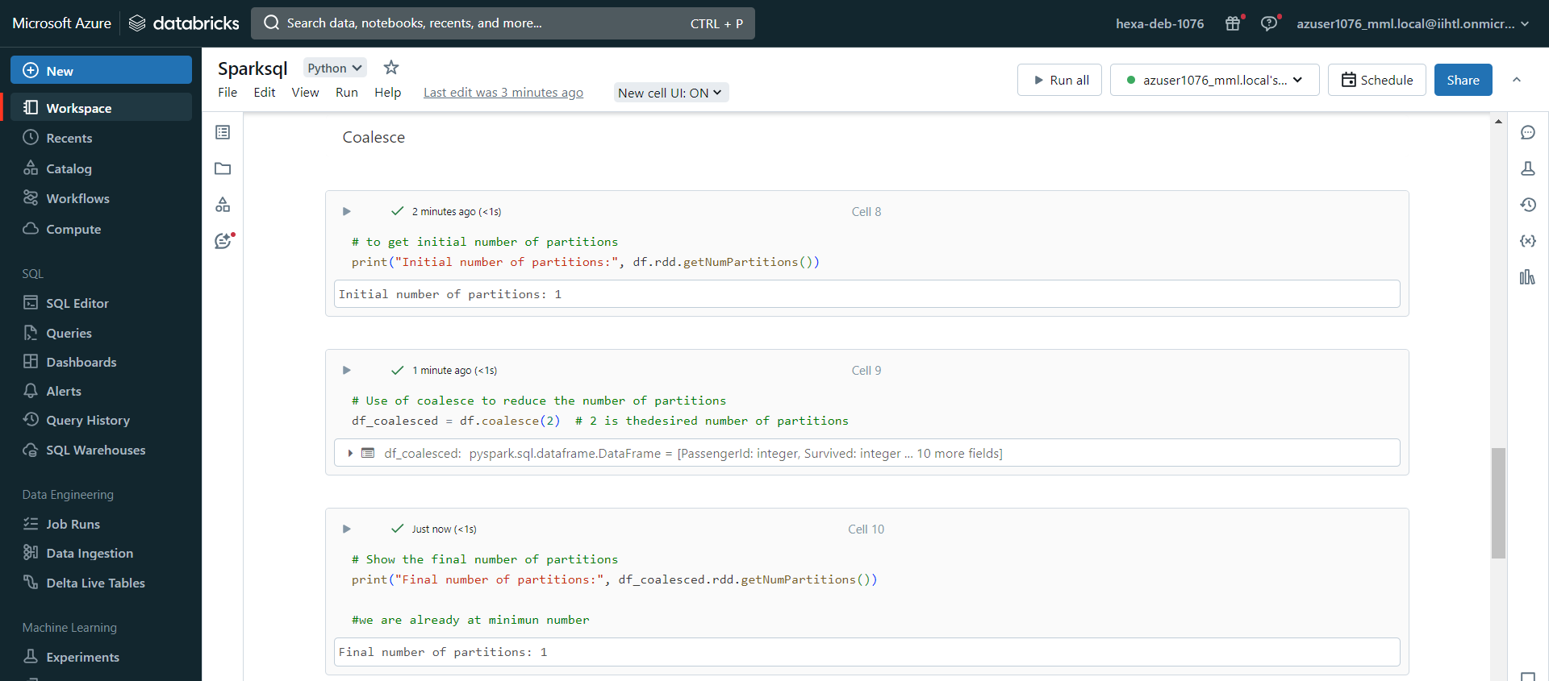
Viewing cache
Coalesce

Slide 15
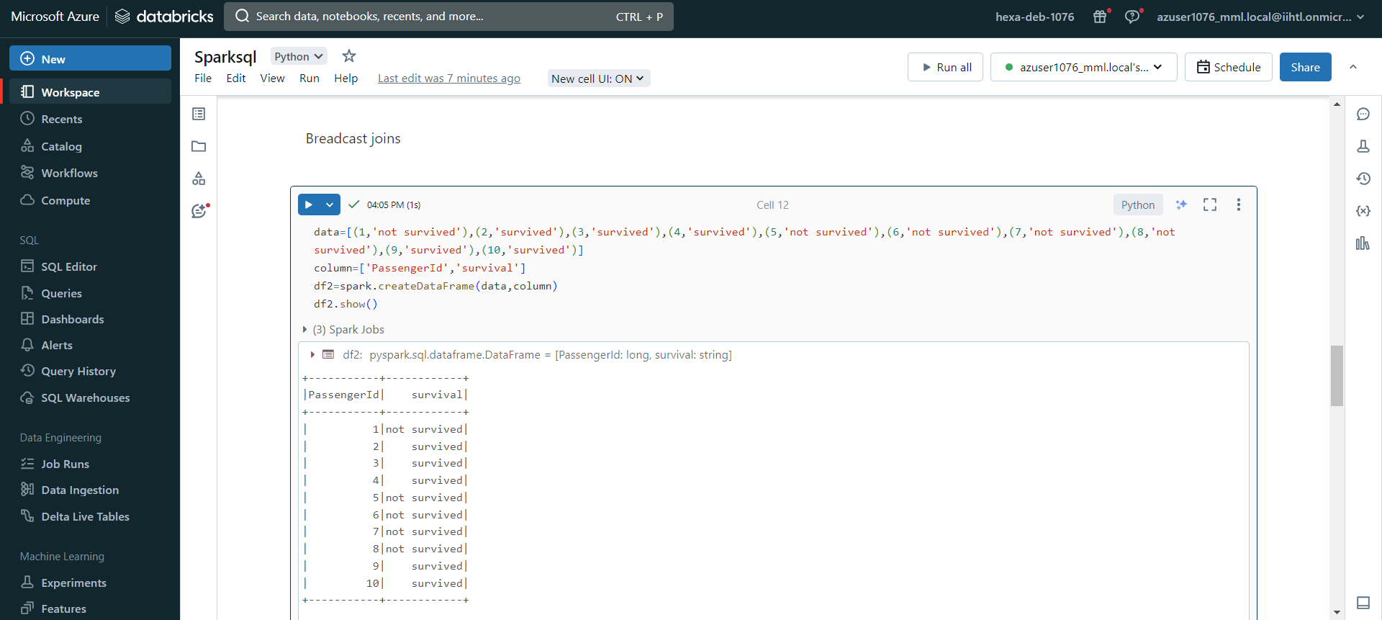
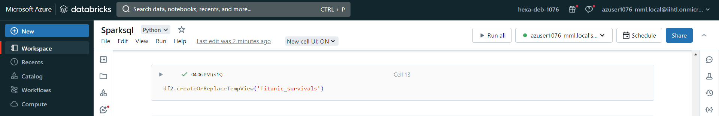
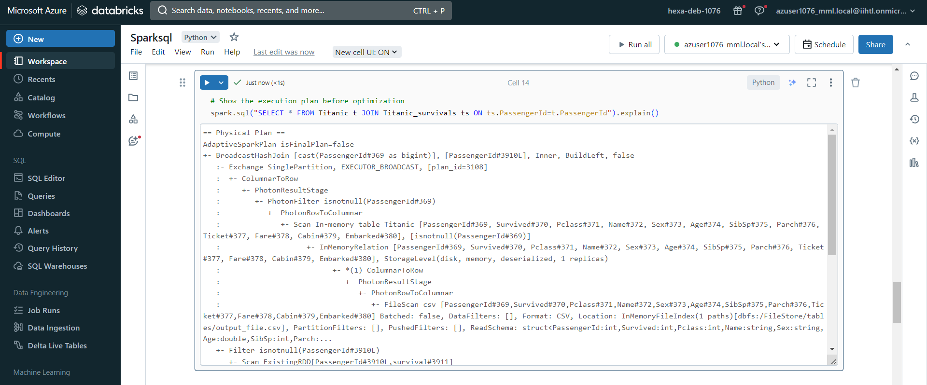
New DataFrame
View
Explaining join procedure

Slide 16
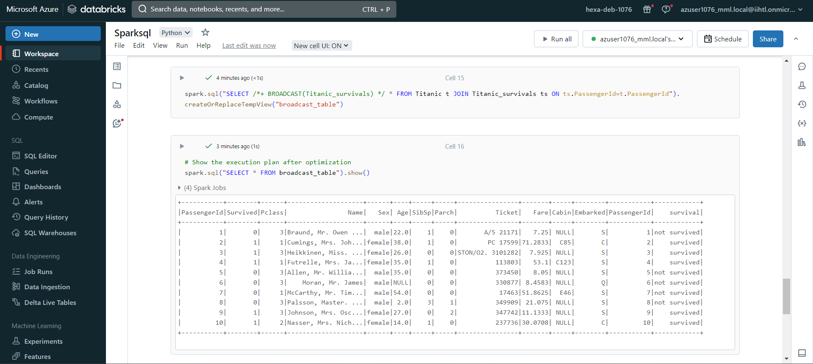

Broadcast
Explaination after broadcast

Slide 17
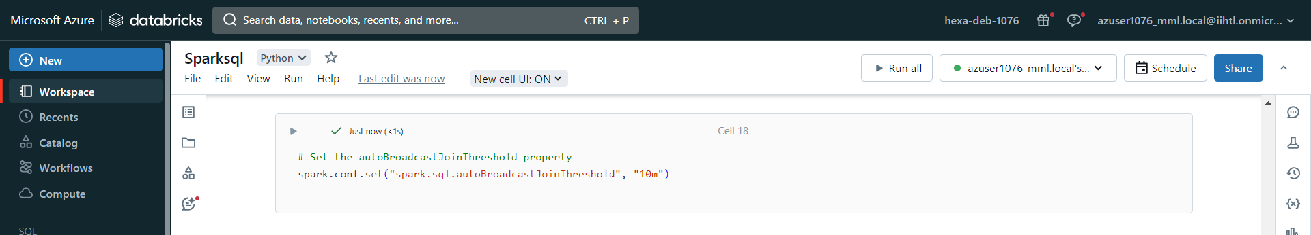
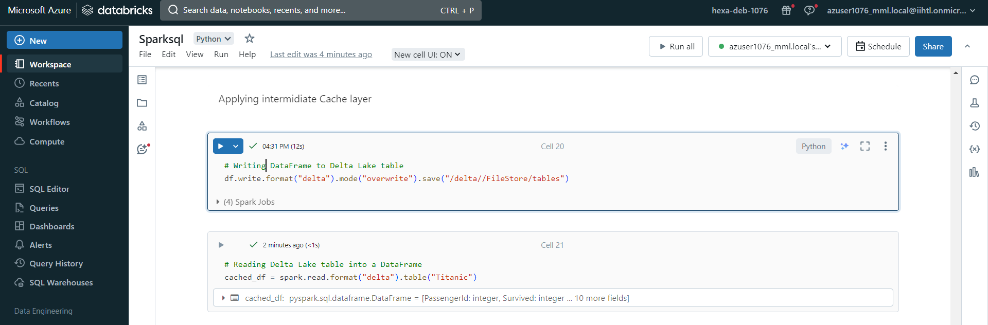
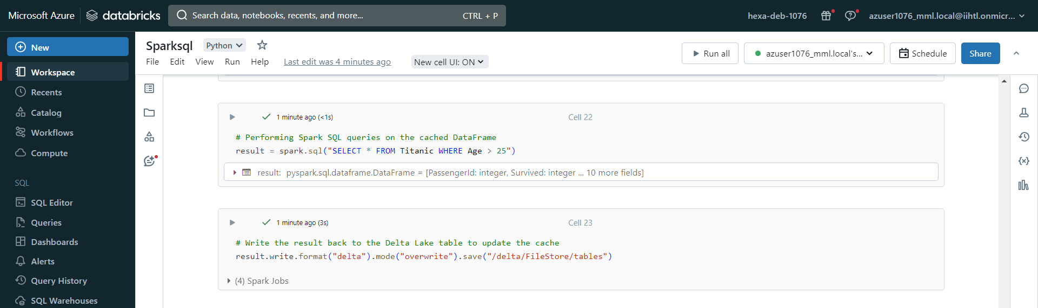
Setting threshold
Delta table
Saving result in delta table

Slide 18
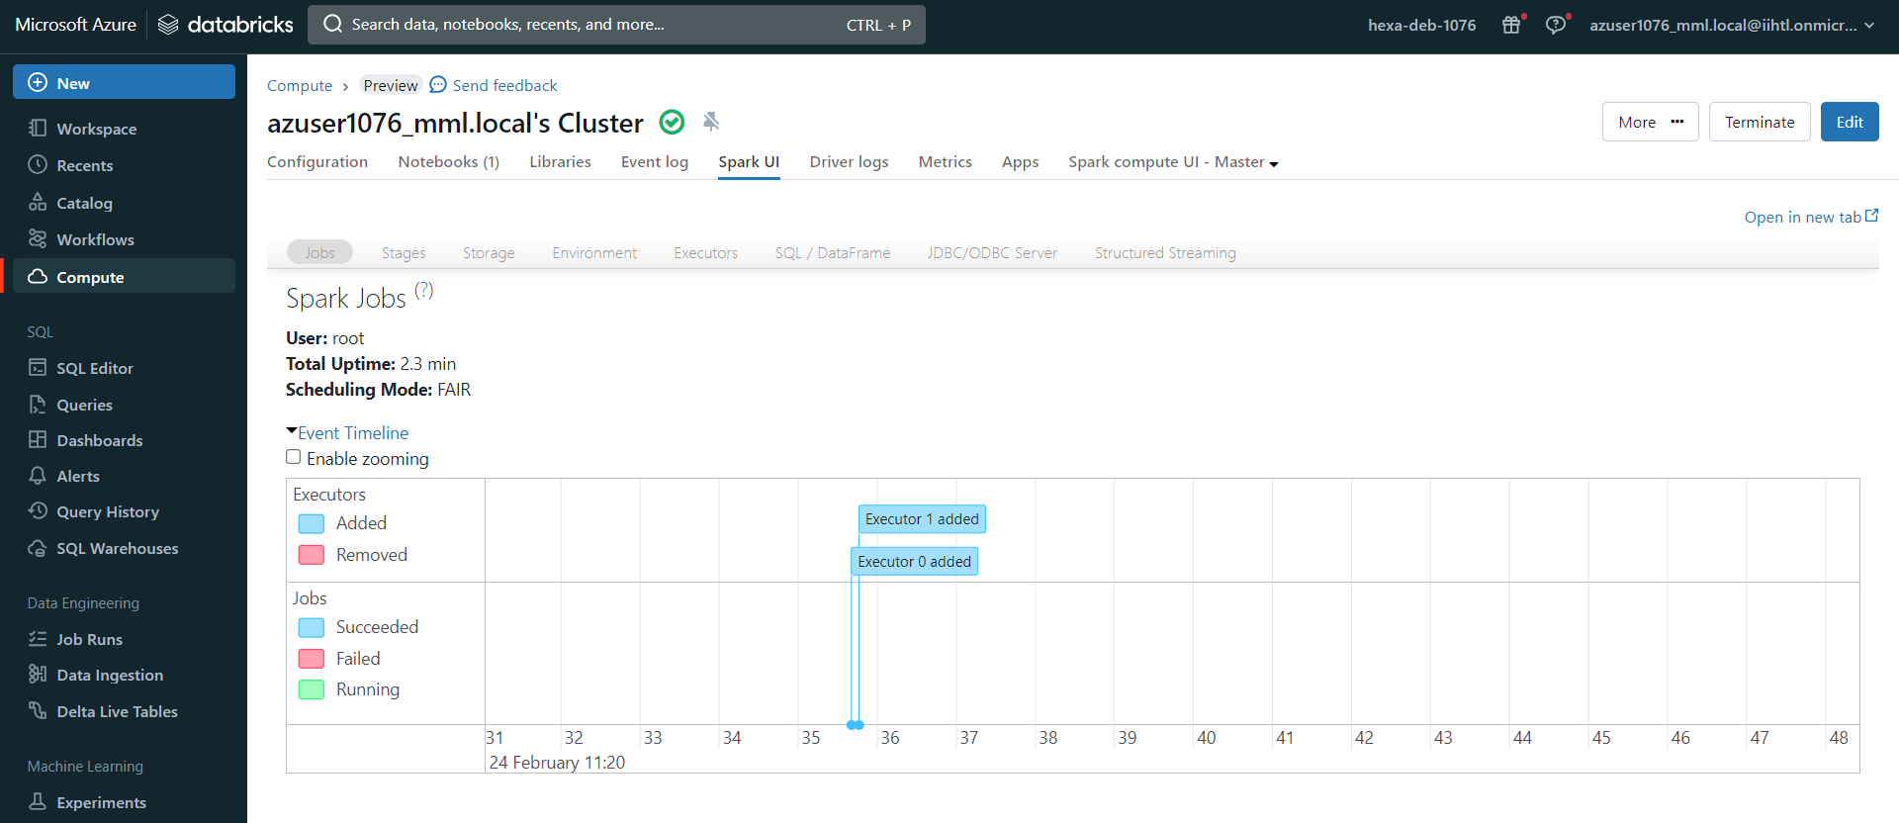
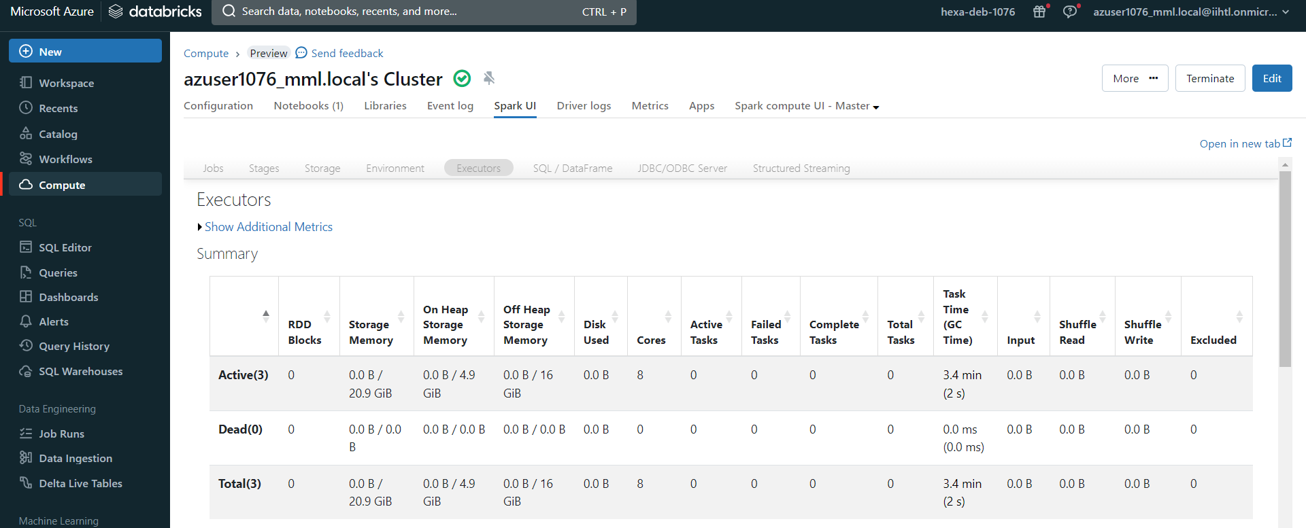
Nodes
Executor nodes

Slide 19
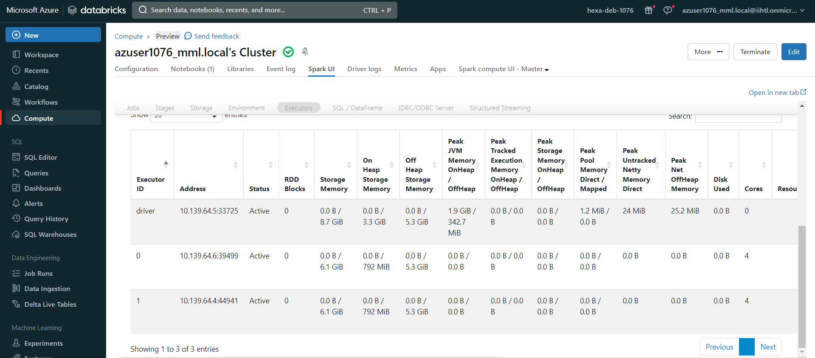
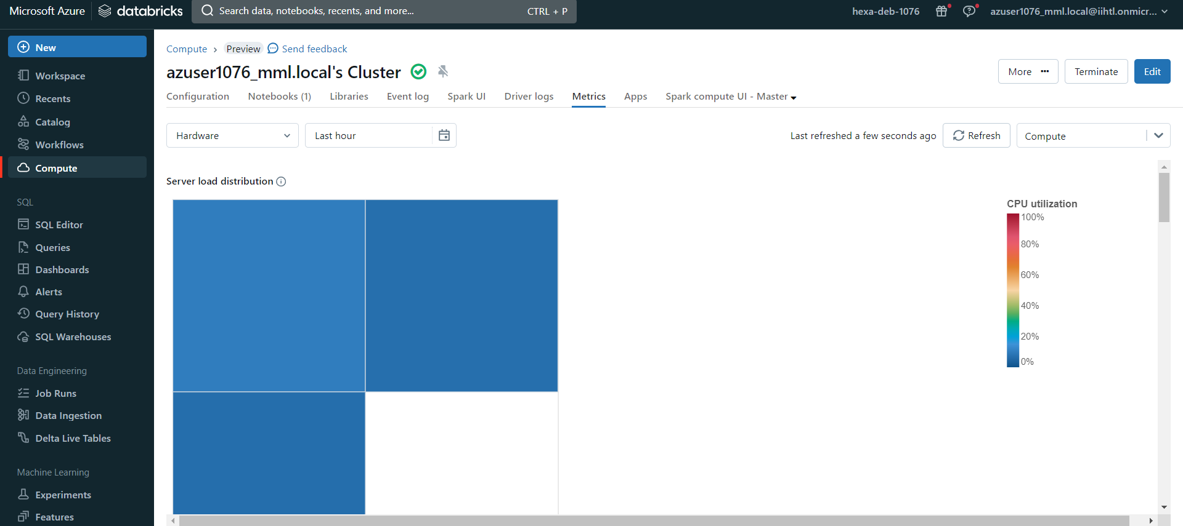
Details of executor nodes
CPU utilization

Slide 20
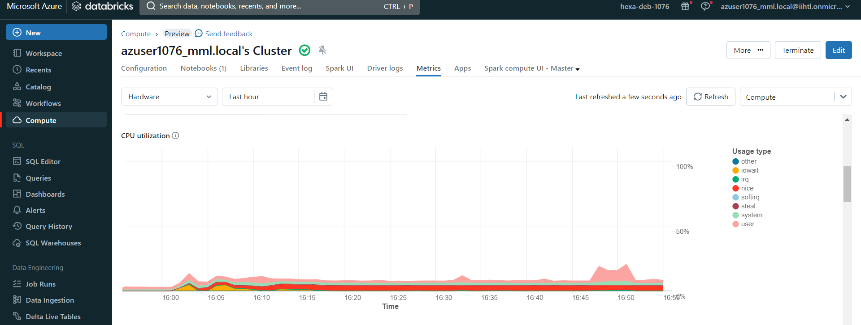
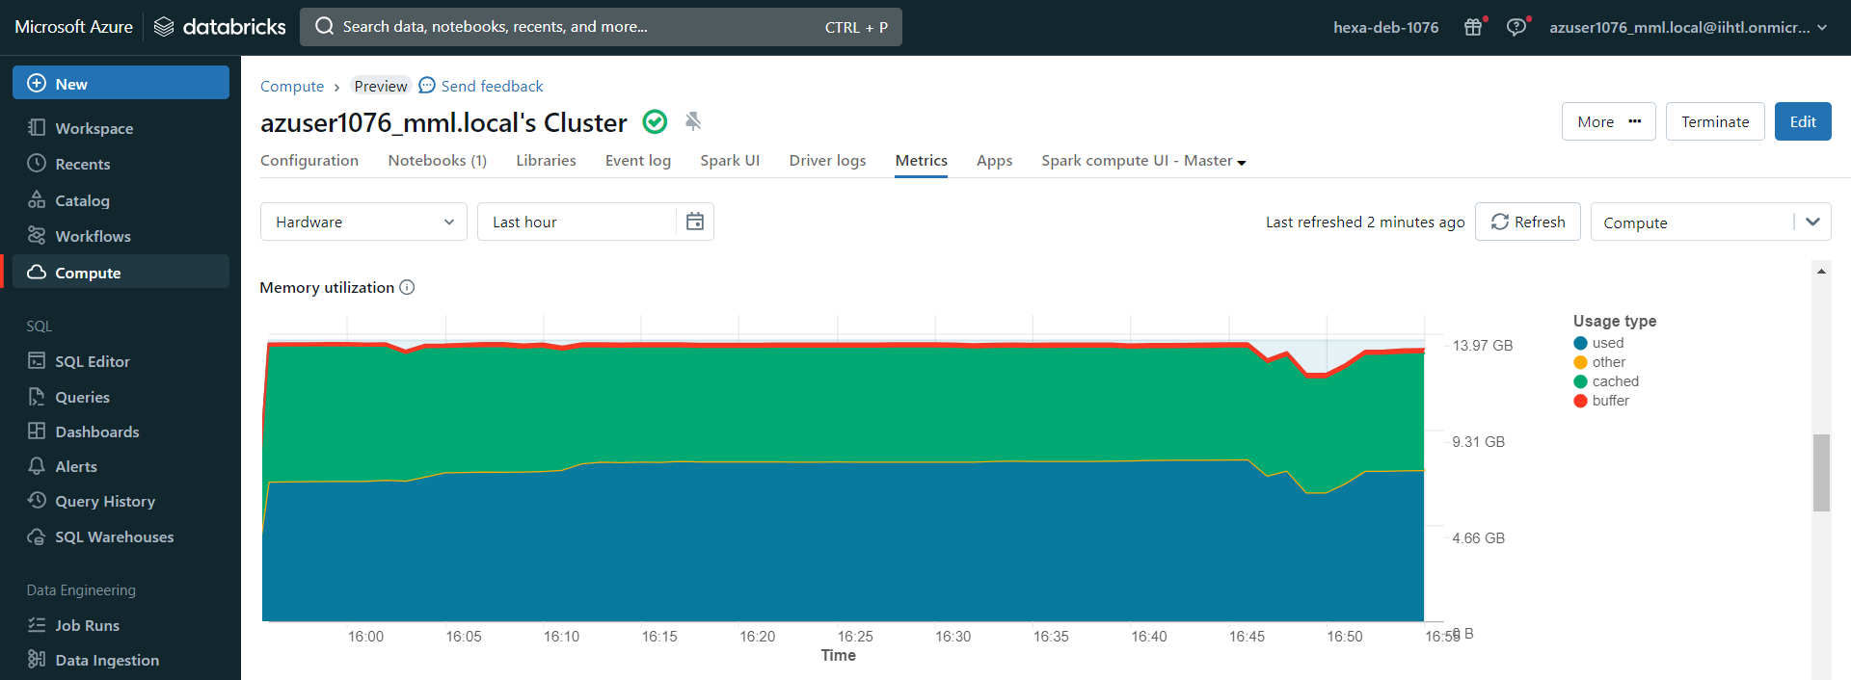
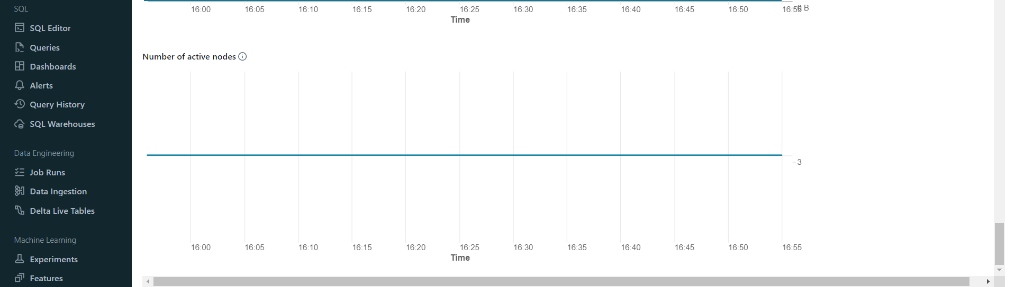
CPU utilization
Memory utilization
Active nodes

Slide 21
Conclusion
This project successfully demonstrates the implementation of cost optimization and efficient cluster management in Databricks using PySparkSQL. By implementing auto-scaling policies, optimizing query performance, and monitoring resource utilization, the project showcases best practices for managing Databricks clusters effectively. The project's outcomes contribute to reducing operational costs, improving performance, and enhancing the overall management of Databricks clusters for data processing and analytics workflows.

